Slide 1
Multilingual Event Detection in the Europe Media Monitor
Hristo Tanev
Joint Research Centre, European Commission

Slide 2
Europe Media Monitor (EMM)
Europe Media Monitor – a multilingual news monitoring platform of the European Commission
EMM processes up to 70 languages
EMM finds entities and trends inside the news

Slide 3
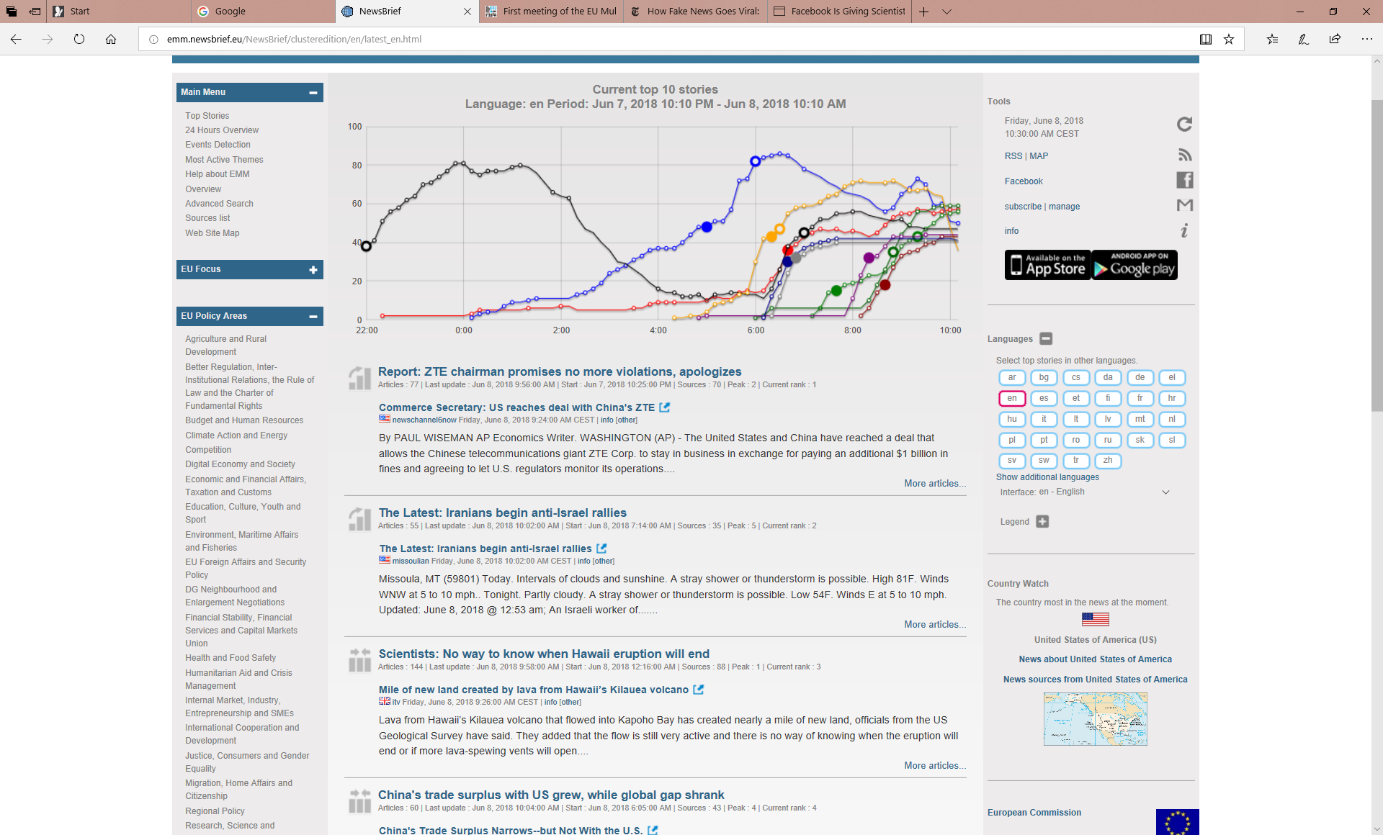

Slide 4
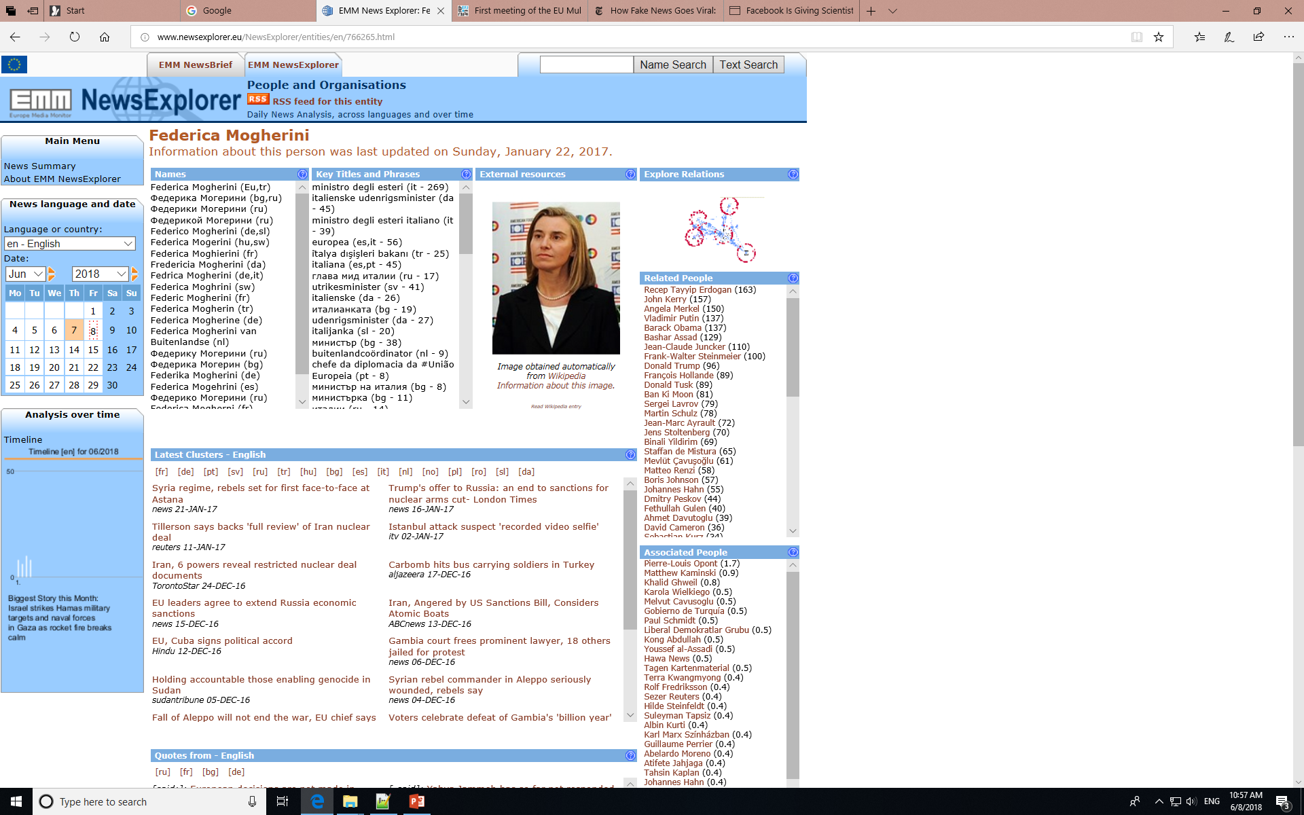

Slide 5
Europe Media Monitor (EMM)
EMM is being used by the analysts of the European Commission and other international organizations and member states
EMM gathers around 220,000 news per day from 5000 online sources
The news represent the major newspapers from all countries in the World with strong focus on Europe

Slide 6
Europe Media Monitor (EMM)
We have 56 news sources from Switzerland
(In comparison we have 53 from Austria)
We monitor also social media (mostly Twitter) for recurrent hash tags, names and shared links

Slide 7
EMM applications
NewsBrief – collects and clusters news in 70 languages in various topics
MediSys – collects news about public health-related issues
NewsExplorer – provides long-term view of the news
NewsDesk – tool for human moderation
EMM Apps – mobile app interfacing EMM
Citizen and Science – a project which collects news from the area of science and technology

Slide 8
Event Detection in EMM
There are two information extraction technologies, implemented in EMM:
  Named Entity Recognition
  Event Metadata Extraction
We detect and extract metadata from articles from the area of security, disasters and health

Slide 9
NEXUS - a Multilingual System for Event Detection
NEXUS has been used in the African Union headquarters, in the European Agency for Border Control Frontex.
It is also part of the Europe Media Monitor

Slide 10
NEXUS – a Multilingual Event Extraction System
NEXUS is software system which has been designed to work in multilingual settings
It is rule based – exploits local grammar rules to perform syntactic and semantic analysis of the text
Uses a large system of keyword combinations to classify the events into categories

Slide 11
Crisis event
Disaster
Security-related
Humanitarian crisis
Medical events
Natural Disaster
Manmade disaster/
accident
Arrest
Trial
Execution
Kidnapping/Hostage
taking
Hostage release
Hostage video
Release
Violent crimes
Robbery
Shooting
Physical attack
Socio political
Protest
Riots
Strikes
Military event
Terrorist attack
Armed conflict
Heavy weapons
Air attack

Slide 12
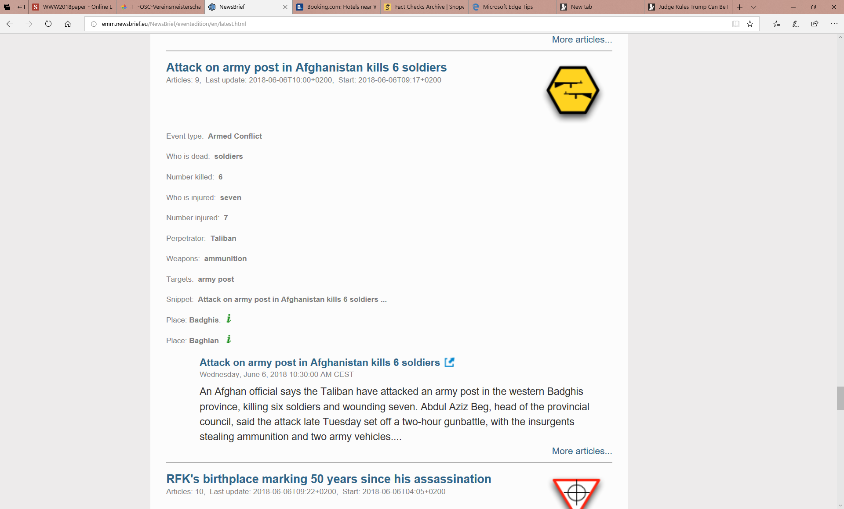

Slide 13
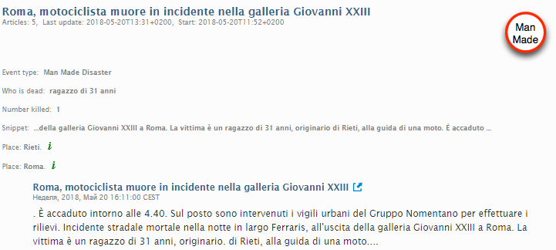
Extracted Events

Slide 14


EMM Pipeline
Entity Recogniser
Cross lingual Clustering
RSS+
<text>
<entity>
<geo>
<quote>
<tonality>
<category>
duplicate=
RSS Cache
Cluster
RSS
Summaries
Typically last 8 hours of RSS per language
Real Time news clustering
Event Extractor
Breaking news, based on cluster growth
Stories
Continuously updated RSS
Mailer/SMS

Slide 15

NEXUS Pipeline

Slide 16

Tokenization and sentence splitting are done via an in-house system for shallow processing
Sentence splitter uses a list of words like Dr. or Prof. which cannot appear at the end of a sentence

Slide 17


Slide 18
NEXUS
Using finite state grammars the system detects in the text information about
  Killed
  Injured
  Perpetrators
  Arrested
  Displaced people
  Targets of attacks – vehicles, buildings, people
  Weapons

Slide 19
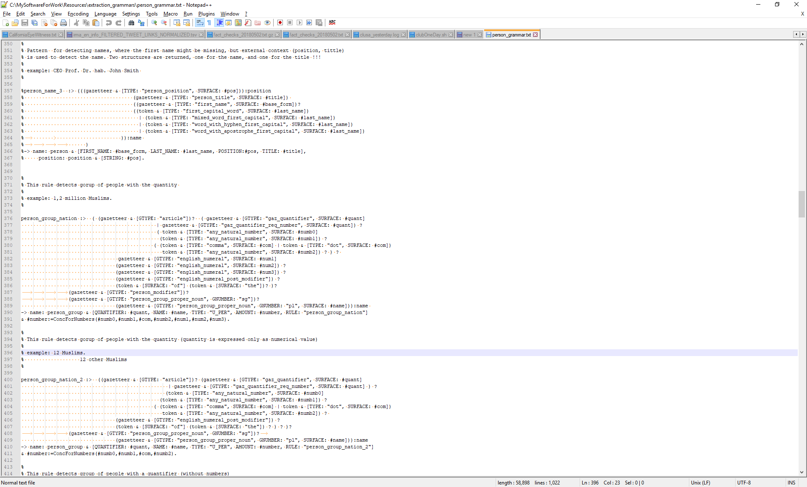
Two-level finite state grammar

Slide 20
Automatic Learning of Lexica
Multilingual weakly supervised lexical learning tool EMM Terminology Discovery
The tool uses distributional semantics
The user inserts on the input a handful of seed words, which belong to a certain semantic category and the system finds many more terms

Slide 21
Automatic Learning of Lexica (example)
For example, if we want to learn a list of weapons, the input seed set can be:
  pistol
  gun
  rifle
The system expands this small seed set into a big set of words: handgun, firearm, knife, shotgun, weapon, revolver, guns, machine gun, pistols,rifles,bullet,….

Slide 22
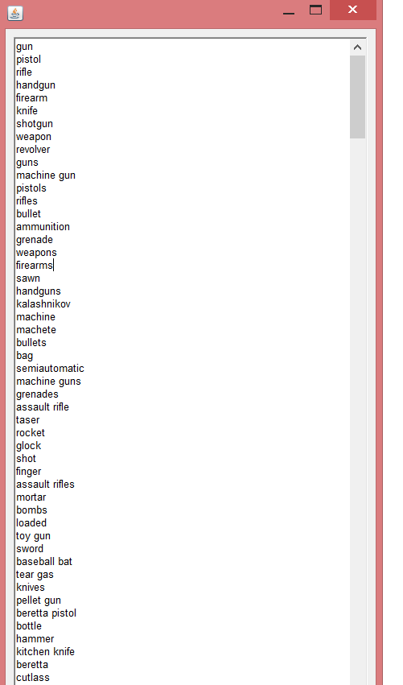
Automatic Learning of Lexica (example)

Slide 23
Semi-Automatic Learning of Grammar Rules for Event Extraction
Extract domain-specific terminology
Find word clusters, using distributional similarity
Find cluster co-occurrences

Slide 24
Semi-Automatic Learning of Grammar Rules for Event Extraction
Automatically extracted terms, co-occurring with killed and injured:
  rioting, bomb blast, gunfight, bomb…., gunfire, enemy fire, sniper, gunshots, sniper fire, stray bullets, bullets,…,paramilitary troopers, militiamen, federal agents, soldiers, gendarmes, troops,…,

Slide 25
Semi-Automatic Learning of Grammar Rules for Event Extraction
Extracted terms are clustered, using distributional similarity
Patterns of cluster co-occurrences are found inside a corpus
[troopers, soldiers, militiamen,...] were [killed,wounded, dead,…], troopers were dead

Slide 26
Semi-Automatic Learning of Grammar Rules for Event Extraction
[killed,wounded,dead,...] in [rioting, bomb blast, gunfight,...], killed in bomb blast
[detonated, exploded,...] the [landmine, bomb, bombs,…], detonated the landmine

Slide 27
Medical Event Extraction
The purpose of the system for medical event extraction is detection of disease outbreaks and the people who are dead and infected in these outbreaks
The system uses grammar rules and extensive list of infectious diseases

Slide 28
Medical Event Extraction
One of the challenges in this domain of application of EE is that multiple stages of the outbreaks can be reported
Currently, the system recognizes different temporal expressions in the text and finds the event descriptions anchored to those temporal expressions

Slide 29
Multiple Event Detection
Taipei, May 22 (CNA) A new imported case of measles has been confirmed in Taipei after a man tested positive for the virus, the Centers for Disease Control (CDC) said Tuesday…So far this year, there have been 25 confirmed cases of measles infection, the highest recorded number in Taiwan in the last seven years, according to the latest CDC data.

Slide 30
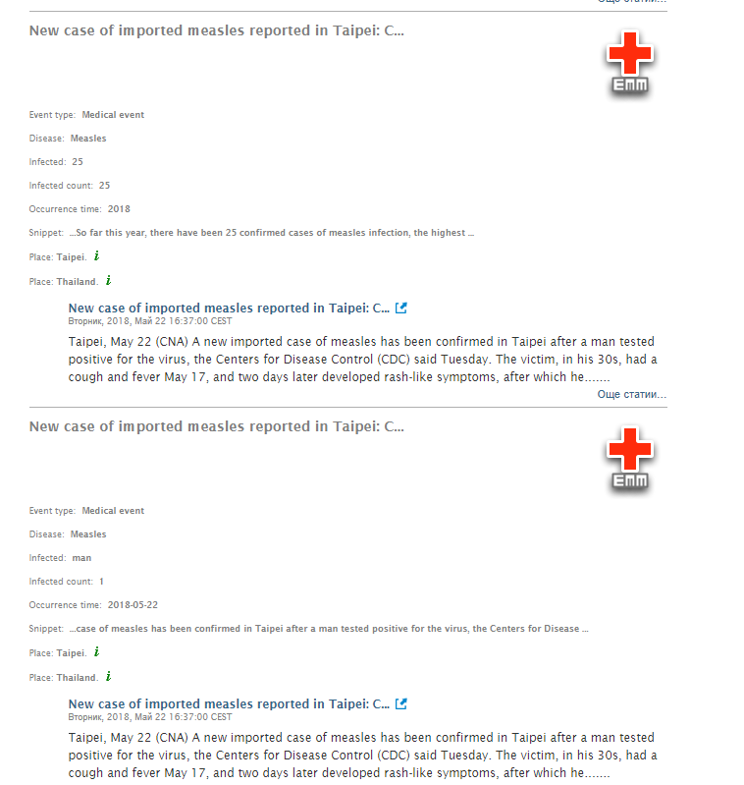

Slide 31
http://emm.newsbrief.eu

